Slide 1
Large-Scale Prediction of Disulphide Bridges Using Kernel Methods, Two-Dimensional Recursive Neural Networks, and Weighted Graph Matching
Jianlin Cheng, Hiroto Saigo, and Pierre Baldi
Structure, Function, and Bioinformatics 62:617–629 (2006)
Presenter : Chih-Ying Lin
Date : June 21, 2009

Slide 2
ABSTRACT
The formation of disulphide bridges between cysteines plays an important role in protein folding, structure, function, and evolution. Here, we develop new methods for predicting disulphide bridges in proteins. We first build a large curated data set of proteins containing disulphide bridges to extract relevant statistics. We then use kernel methods to predict whether a given protein chain contains intrachain disulphide bridges or not, and recursive neural networks to predict the bonding probabilities of each pair of cysteines in the chain. These probabilities in turn lead to an accurate estimation of the total number of disulphide bridges and to a weighted graph matching problem that can be addressed efficiently to infer the global disulphide bridge connectivity pattern. This approach can be applied both in situations where the bonded state of each cysteine is known, or in ab initio mode where the state is unknown. Furthermore, it can easily cope with chains containing an arbitrary number of disulphide bridges, overcoming one of the major limitations of previous approaches. It can classify individual cysteine residues as bonded or nonbonded with 87% specificity and 89% sensitivity.

Slide 3
ABSTRACT
The estimate for the total number of bridges in each chain is correct 71% of the times, and within one from the true value over 94% of the times. The prediction of the overall disulphide connectivity pattern is exact in about 51% of the chains. In addition to using profiles in the input to leverage evolutionary information, including true (but not predicted) secondary structure and solvent accessibility (溶劑可接觸性) information yields small but noticeable improvements. Finally, once the system is trained, predictions can be computed rapidly on a proteomic or protein-engineering scale. The disulphide bridge prediction server (DIpro), software, and datasets are available through www.igb.uci.edu/servers/pass.html. Proteins 2006;62:617–629.

Slide 4
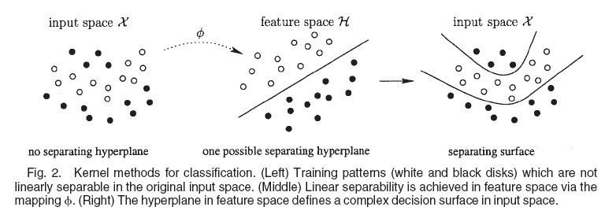
Kernel Methods for Chain Classification

Slide 5
Kernel Methods
Spectrum kernel
Mismatch kernel
Profile kernel
Smith–Waterman kernel
Local alignment kernel
Fisher kernel

Slide 6
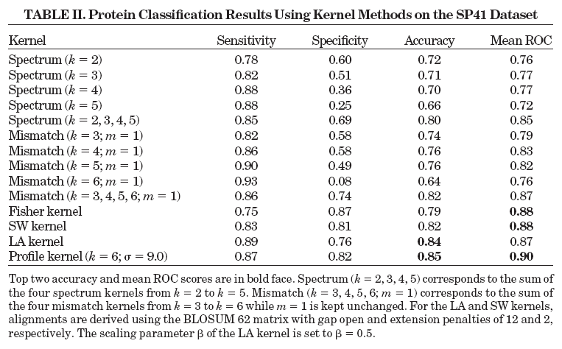
Protein Chain Classification

Slide 7
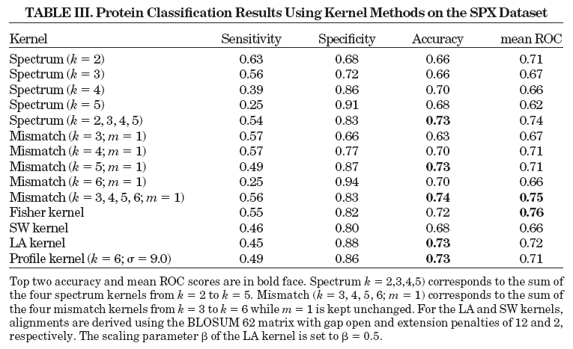
Protein Chain Classification

Slide 8
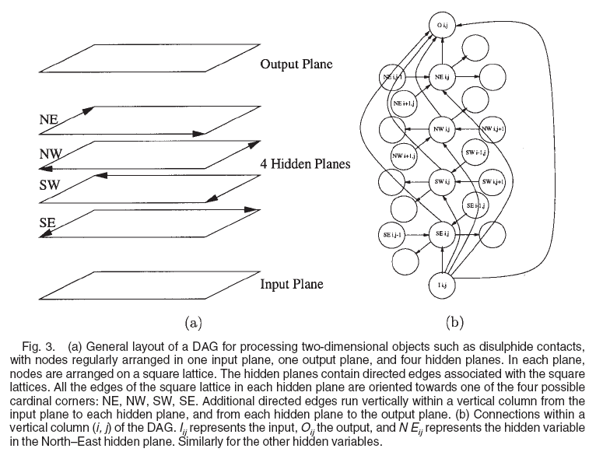
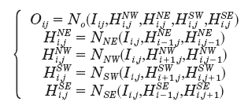
2D DAG-RNN (Directed Acyclic Graph-Recursive Neural Network)

Slide 9
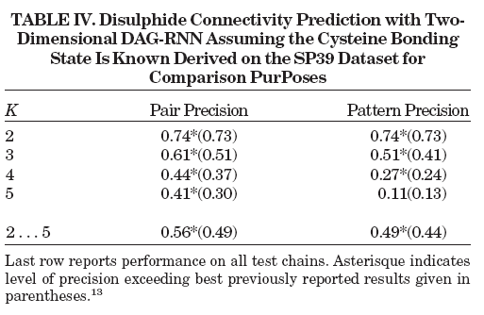
Disulphide Connectivity Prediction

Slide 10
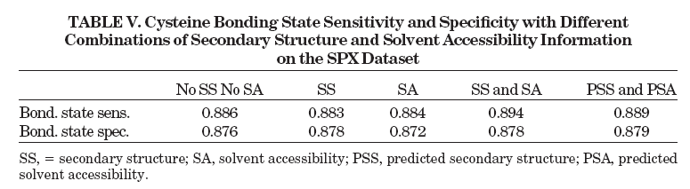
Prediction of cysteine bonding states

Slide 11
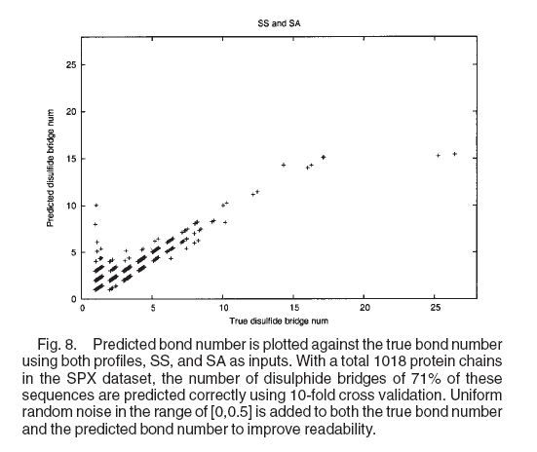
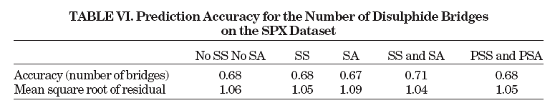
Prediction of the number of disulphide bridges
2K and S(p) 0.89
2K and M 0.87
2K and S(p)logM 0.94

Slide 12
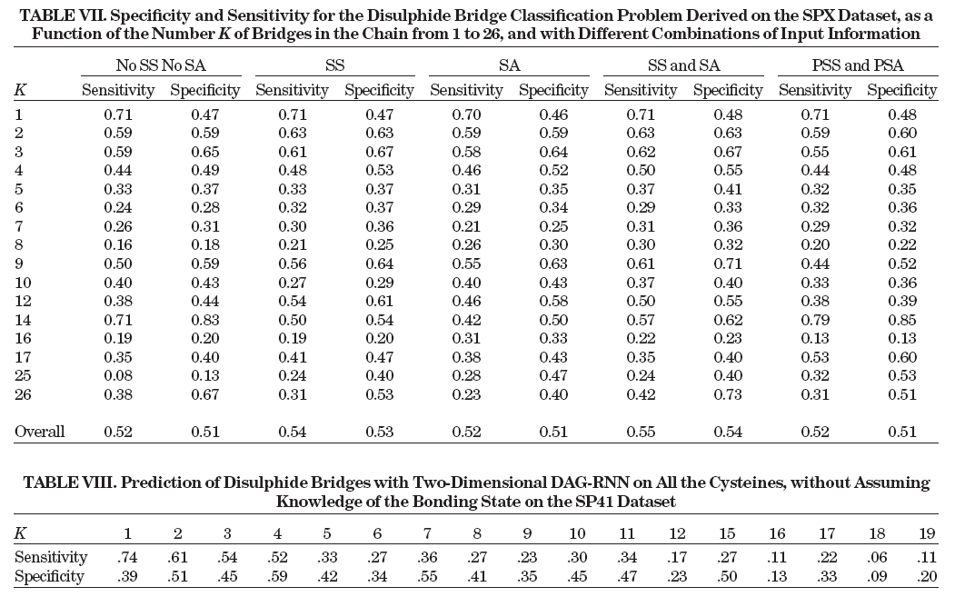
Disulphide Bridge Classification

Slide 13
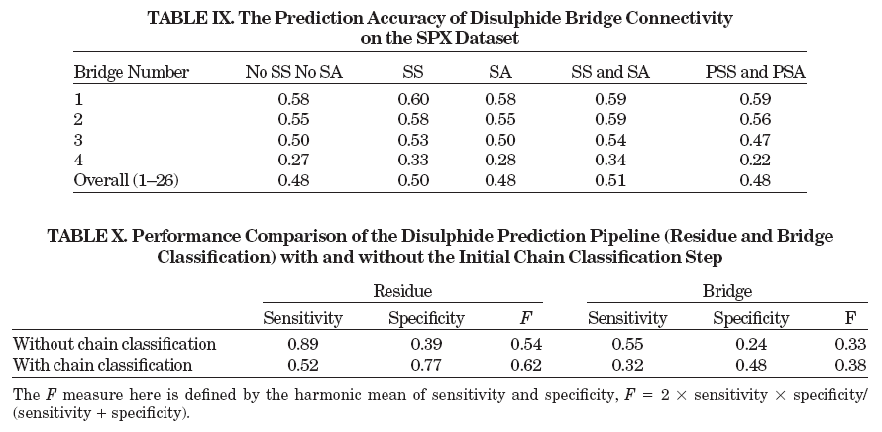
Disulphide Connectivity Prediction

Slide 14
Sensitivity and specificity
True positive: Sick people correctly diagnosed as sick
False positive: Healthy people wrongly identified as sick
True negative: Healthy people correctly identified as healthy
False negative: Sick people wrongly identified as healthy

